Slide 1
RISC-V Instruction Formats, Part I

Slide 2

Computing in the News
The vulnerability lies in a hardware-level security mechanism utilized in Apple M1 chips called pointer authentication codes, or PAC. This feature makes it much harder for an attacker to inject malicious code into a device’s memory …
Researchers from MIT’s [CSAIL], however, have created a novel hardware attack, which combines memory corruption and speculative execution attacks to sidestep the security feature. The attack shows that pointer authentication can be defeated without leaving a trace, and as it utilizes a hardware mechanism, no software patch can fix it.
https://techcrunch.com/2022/06/10/apple-m1-unpatchable-flaw/

Slide 3
Machine Language
Machine Language
R-Format Layout
I-Format Layout
I-Format: Load
S-Format Layout (Store)

Slide 4


Great Idea #1: Abstraction (Levels of Representation/Interpretation)
High Level Language Program (e.g., C)
temp = v[k];
v[k] = v[k+1];
v[k+1] = temp;
Compiler
Anything can be represented as a number, i.e., data or instructions
Assembly Language Program (e.g., RISC-V)
lw x3, 0(x10)
lw x4, 4(x10)
sw x4, 0(x10)
sw x3, 4(x10)
Assembler
1000 1101 1110 0010 0000 0000 0000 0000
1000 1110 0001 0000 0000 0000 0000 0100
1010 1110 0001 0010 0000 0000 0000 0000
1010 1101 1110 0010 0000 0000 0000 0100
Machine Language Program (RISC-V)
Hardware Architecture Description (e.g., block diagrams)
+4
Reg
[]
pc
pc+4
1
wb
DataD
Reg
[rs1]
1
ALU
alu
2
alu
0
pc
IMEM
inst
[11:7]
AddrD
Reg
[rs2]
0
Addr
DMEM
1
wb
pc+4
inst
[19:15]
AddrA
DataA
Branch
0
DataW
DataR
mem
0
Architecture Implementation
inst
[24:20]
AddrB
DataB
Comp.
1
Logic Circuit Description (Circuit Schematic Diagrams)
inst
[31:7]
Imm
.
imm
[31:0]
Gen

Slide 5

Quick CS History: ENIAC (UPenn, 1946)
First Electronic General-Purpose Computer
Blazingly fast!
Multiply 10 x 10 decimal digits in 2.8 ms
…but needed 2-3 days to set up new program.
Programming meant patch cords and switches
Betty Snyder, one of the six original ENIAC “computers,” i.e., programmers
Notes:
Electronic Numerical Integrator and Computer
Numerical Integrator and Computer
-Digital (electronic), capable of being reprogrammed to solve a variety of mathematical problems
-Dev began at the end of WWII, was designed and primarily used to calculate artillery firing tables for the US Army’s
-Very slow to program
-Story about 2 architects who designed it and Von Neumann, how it led to EDSAC
-Slow program entry, I/O
Betty Snyder Holberton

Slide 6
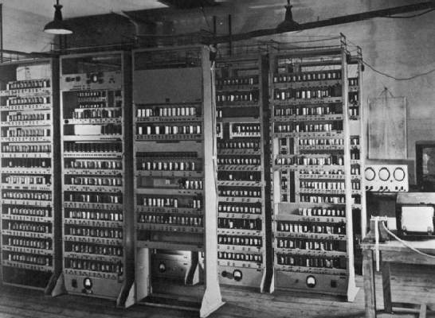
Quick CS History: EDSAC (Cambridge, 1949)
First General Stored-Program Electronic Computer
17-bit words (35-bit double word), binary 2’s complement
Memory: 512 words
Multiplication: 6ms
Subroutines
At some point,
Notes:
EDVAC: Electronic Discrete Variable Automatic Computer
EDSAC: Electronic Delay Storage Automatic Calculator

Slide 7
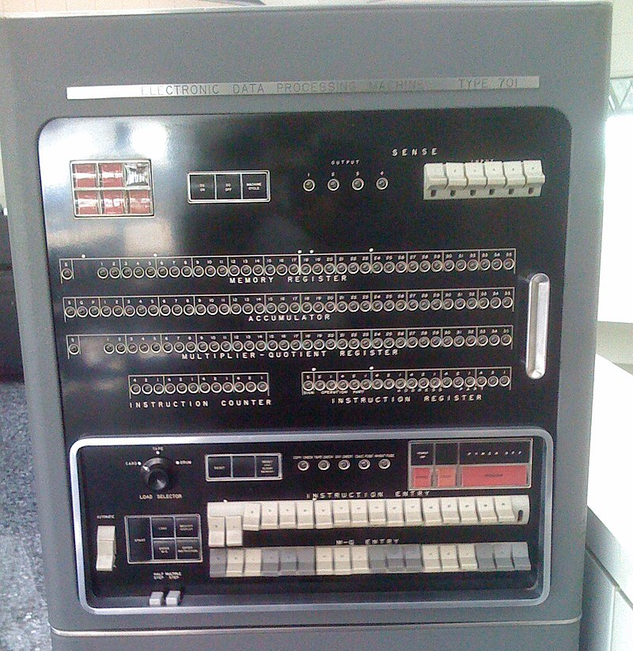
Quick CS History: IBM 701 (1952)
IBM’s first commercial scientific computer
36-bit sign-magnitude words
Memory: 2048 words with vacuum tubes
Multiplication: <0.5 ms
Two programmer-accessible registers: Accumulator, Multiplier/Quotient
https://www.ibm.com/ibm/history/exhibits/701/701_intro.html

Slide 8
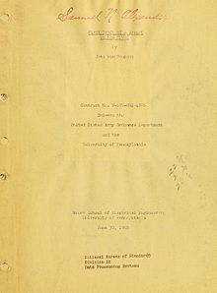
History’s Big Idea: Stored Program Computer
Instructions are represented as bit patterns (i.e., numbers).
Therefore, entire programs can be stored to memory to be read or written, just like data.
This means reprogramming can happen quickly (seconds); don’t have to rewire computer (days).
Stored-Program Computer AKA the “von Neumann” computer is named after the widely distributed tech report
Based on discussions of EDVAC (1944-): Eckert, Mauchly
Anticipated earlier by Turing and Zuse
First Draft of a Report on the EDVAC
By John von Neumann
Contract No. W–670–ORD–4926
Between the
United States Army Ordnance Department and the
University of Pennsylvania
Moore School of Electrical Engineering
University of Pennsylvania
June 30, 1945
Notes:
Herman Goldstine
Alan Turing, Konrad Zuse

Slide 9
Stored Program Computer: Implications
Everything (instructions, data words) has a memory address.
Both branches and jumps use instruction memory addresses.
C pointers are just memory addresses and can point to anything.
Unconstrained use of addresses lead to nasty bugs! Up to C programmer to avoid errors
The Program Counter (PC) register keeps address of instruction being executed.
PC is effectively a pointer to memory; Intel calls it Instruction Pointer (PC).
Programs are distributed in binary form, i.e., as assembled machine code.
Programs are each bound to a specific instruction set.
Different instruction sets, e.g., for phone vs. PCs.
Many instruction sets are backwards-compatible and evolve over time.
E.g., latest PCs with x86 ISA today can still run programs from Intel 8088 (1981)!

Slide 10
Instructions Are 32 Bits Wide
ISA defines instructions for CPU down to the bit level:
Remember: Computer only understands 1s and 0s. Text like “add x18,x19,x10” is meaningless to hardware.
Most data we work with is in words (32-bit chunks).
32b registers; lw, sw access memory one word at a time.
Similarly, RISC-V instructions are fixed size, 32-bit words.
RISC-V seeks simplicity: since data is in words, make instructions be fixed-size 32-bit words also.
Same 32-bit instructions used for RV32, RV64, RV128
add x18, x19, x10
00000000101010011000100100110011
assembly code
machine code

Slide 11
Instruction Formats
file:///Users/yanlisa/Downloads/riscv-spec-20191213.pdf
RISC-V’s 32b instruction words are divided into fields.
Each field tells processor something about the instruction.
The RISC-V ISA defines six basic types of instruction formats.
RISC-V seeks simplicity: Avoid defining different fields for each instruction; instead, use same format for similar instructions.
R-Format | Register-register arithmetic operations
I-Format | Register-immediate arithmetic operations; Loads
S-Format | Stores
B-Format | Branches (minor variant of S-format)
U-Format | 20-bit upper immediate instructions
J-Format | Jumps (minor variant of U-format)
today

Slide 12
R-Format Layout
Machine Language
R-Format Layout
I-Format Layout
I-Format: Load
S-Format Layout (Store)

Slide 13
R-Format Instruction Layout
Register-Register Arithmetic Instructions (add, xor, sll, etc.)
opname rd, rs1, rs2
field’s bit positions
31 |  |  |  | 25 | 24 |  | 20 | 19 |  | 15 | 14 | 12 | 11 |  | 7 | 6 |  |  |  | 0
funct7 |  |  |  |  | rs2 |  |  | rs1 |  |  | funct3 |  | rd |  |  | opcode
7 |  |  |  |  | 5 |  |  | 5 |  |  | 3 |  | 5 |  |  | 7
name of field
# bits in field

Slide 14
R-Format Instruction Layout
Register-Register Arithmetic Instructions (add, xor, sll, etc.)
opname rd, rs1, rs2
31 |  |  |  | 25 | 24 |  | 20 | 19 |  | 15 | 14 | 12 | 11 |  | 7 | 6 |  |  |  | 0
funct7 |  |  |  |  | rs2 |  |  | rs1 |  |  | funct3 |  | rd |  |  | opcode
7 |  |  |  |  | 5 |  |  | 5 |  |  | 3 |  | 5 |  |  | 7
opcode partially specifies which instruction it is.
funct7, funct3 combined with opcode describes what operation to perform.
Why not just a 17-bit field for simplicity? We’ll answer this later…
All R-Format instructions have opcode 0110011.

Slide 15
R-Format Instruction Layout
Register-Register Arithmetic Instructions (add, xor, sll, etc.)
opname rd, rs1, rs2
31 |  |  |  | 25 | 24 |  | 20 | 19 |  | 15 | 14 | 12 | 11 |  | 7 | 6 |  |  |  | 0
funct7 |  |  |  |  | rs2 |  |  | rs1 |  |  | funct3 |  | rd |  |  | opcode
7 |  |  |  |  | 5 |  |  | 5 |  |  | 3 |  | 5 |  |  | 7
“Source” Register 2
contains second operand
“Source” Register 1
contains first operand
“Destination” Register gets result of computation
Register field (rs1, rs2, rd) holds a 5-bit unsigned integer [0-31] corresponding to a register number (x0-x31).

Slide 16
R-Format Example
add x18, x19, x10
“add”
Reg-Reg opcode
31 |  |  |  | 25 | 24 |  | 20 | 19 |  | 15 | 14 | 12 | 11 |  | 7 | 6 |  |  |  | 0
funct7 |  |  |  |  | rs2 |  |  | rs1 |  |  | funct3 |  | rd |  |  | opcode
0000000 |  |  |  |  | 01010 |  |  | 10011 |  |  | 000 |  | 10010 |  |  | 0110011
7 |  |  |  |  | 5 |  |  | 5 |  |  | 3 |  | 5 |  |  | 7
rs2
10
rs1
19
rd
18

Slide 17
All ten RV32 R-Format Instructions
Eight funct3 fields for ten instructions
funct7 |  |  | funct3 |  | opcode
0000000 | rs2 | rs1 | 000 | rd | 0110011 | add
0100000 | rs2 | rs1 | 000 | rd | 0110011 | sub
0000000 | rs2 | rs1 | 001 | rd | 0110011 | sll
0000000 | rs2 | rs1 | 010 | rd | 0110011 | slt
0000000 | rs2 | rs1 | 011 | rd | 0110011 | sltu
0000000 | rs2 | rs1 | 100 | rd | 0110011 | xor
0000000 | rs2 | rs1 | 101 | rd | 0110011 | srl
0100000 | rs2 | rs1 | 101 | rd | 0110011 | sra
0000000 | rs2 | rs1 | 110 | rd | 0110011 | or
0000000 | rs2 | rs1 | 111 | rd | 0110011 | and
2’s comp negation of rs2
set less than (see refcard)
sign extend
Different funct7 & funct3 encodings select different operations.
Notes:
rd = (rs1 < rs2) ? 1 : 0

Slide 18
Your Turn
How do we encode add x4, x3, x2 ?
Lookup table:
funct3
funct7 |  |  |  |  | opcode
0000000 | rs2 | rs1 | 000 | rd | 0110011 | add
0100000 | rs2 | rs1 | 000 | rd | 0110011 | sub
0000000 | rs2 | rs1 | 100 | rd | 0110011 | xor
0000000 | rs2 | rs1 | 111 | rd | 0110011 | and
4021 8233_{hex}
0021 82b3_{hex}
4021 82b3_{hex}
0021 8233_{hex}
0021 8234_{hex}
Something else
31 |  |  |  | 25 | 24 |  | 20 | 19 |  | 15 | 14 | 12 | 11 |  | 7 | 6 |  |  |  | 0
funct7 |  |  |  |  | rs2 |  |  | rs1 |  |  | funct3 |  | rd |  |  | opcode
pollev.com/yanl

Slide 19
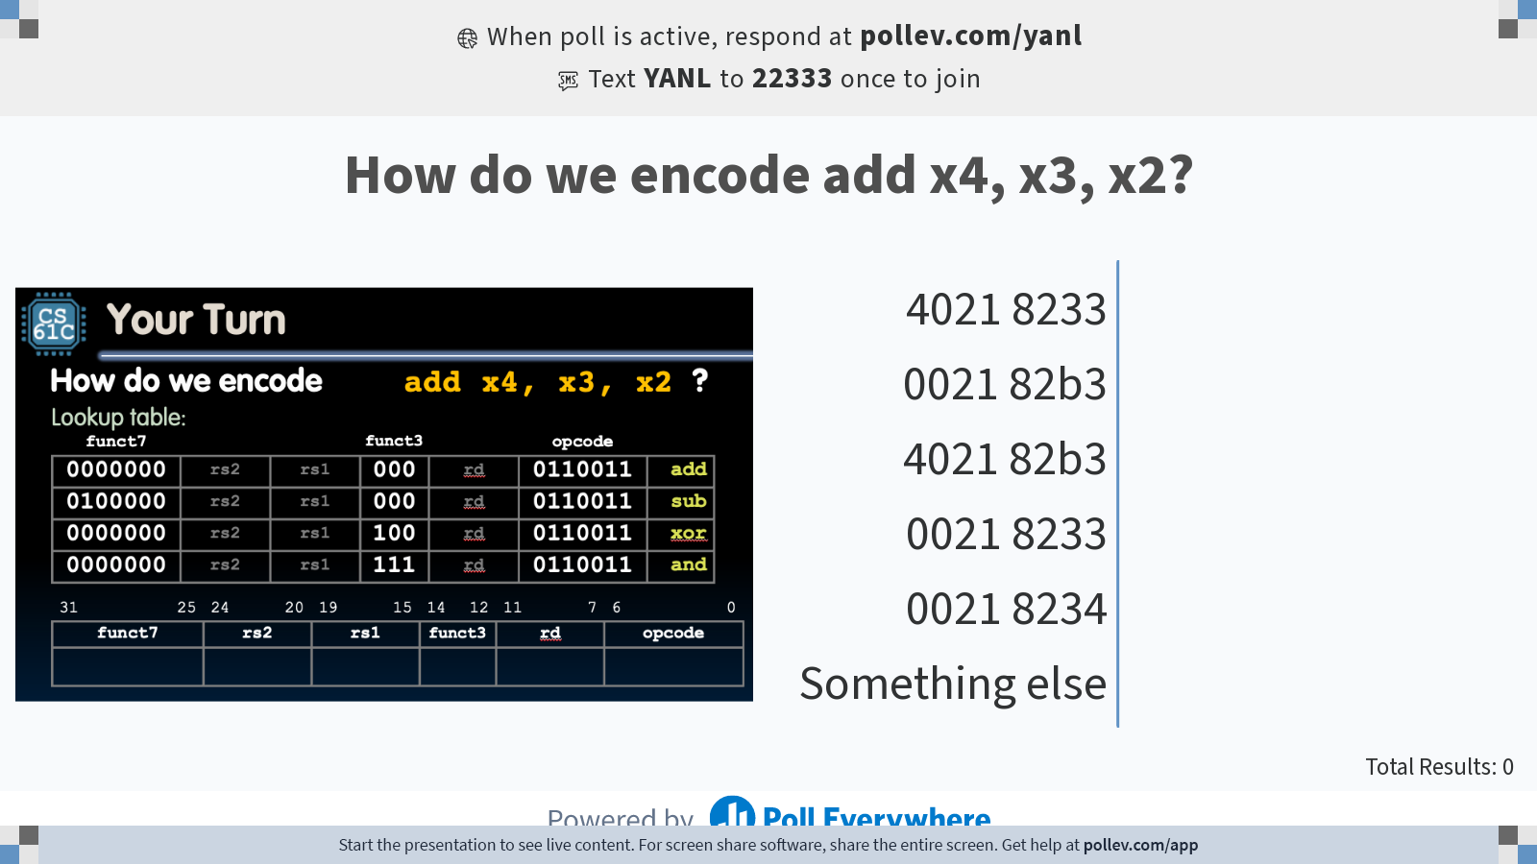
Notes:
Do not modify the notes in this section to avoid tampering with the Poll Everywhere activity. More info at polleverywhere.com/support How do we encode add x4, x3, x2?
https://www.polleverywhere.com/multiple_choice_polls/rEpFTcjLm2Xtb8Dfrhkqt?state=opened&flow=Default&onscreen=persist

Slide 20
Your Turn
How do we encode add x4, x3, x2 ?
Lookup table:
funct3
funct7 |  |  |  |  | opcode
0000000 | rs2 | rs1 | 000 | rd | 0110011 | add
0100000 | rs2 | rs1 | 000 | rd | 0110011 | sub
0000000 | rs2 | rs1 | 100 | rd | 0110011 | xor
0000000 | rs2 | rs1 | 111 | rd | 0110011 | and
4021 8233_{hex}
0021 82b3_{hex}
4021 82b3_{hex}
0021 8233_{hex}
0021 8234_{hex}
Something else
4021 8233_{hex}
0021 82b3_{hex}
4021 82b3_{hex}
0021 8233_{hex}
0021 8234_{hex}
Something else
31 |  |  |  | 25 | 24 |  | 20 | 19 |  | 15 | 14 | 12 | 11 |  | 7 | 6 |  |  |  | 0
funct7 |  |  |  |  | rs2 |  |  | rs1 |  |  | funct3 |  | rd |  |  | opcode
0000000
00010
00011
000
00100
0110011
0
0
2
1
8
2
3
3

Slide 21
I-Format Layout
Machine Language
R-Format Layout
I-Format Layout
Load (I-Format)
S-Format Layout (Store)

Slide 22
Immediate Fields Need to be Wider
R-Format: add rd, rs1, rs2
What about instructions with immediates? addi rd, rs1, imm
If we used R-Format, we’d only be able to represent 32 values in the 5-bit rs2 field.
Immediates may be (and are often) much bigger!
Enter the I-Format:
31 |  |  |  | 25 | 24 |  | 20 | 19 |  | 15 | 14 | 12 | 11 |  | 7 | 6 |  |  |  | 0
funct7 |  |  |  |  | rs2 |  |  | rs1 |  |  | funct3 |  | rd |  |  | opcode
7 |  |  |  |  | 5 |  |  | 5 |  |  | 3 |  | 5 |  |  | 7
31 |  |  |  |  |  |  | 20 | 19 |  | 15 | 14 | 12 | 11 |  | 7 | 6 |  |  |  | 0
imm[11:0] |  |  |  |  | rs2 |  |  | rs1 |  |  | funct3 |  | rd |  |  | opcode
12 |  |  |  |  |  |  |  | 5 |  |  | 3 |  | 5 |  |  | 7
I-Format is mostly consistent with R-Format. Simplify how the CPU processes instructions!

Slide 23
I-Format Instruction Layout
Register-Immediate Arithmetic Instructions (addi, xori, etc.)
opname rd, rs1, imm
31 |  |  |  |  |  |  | 20 | 19 |  | 15 | 14 | 12 | 11 |  | 7 | 6 |  |  |  | 0
imm[11:0] |  |  |  |  | rs2 |  |  | rs1 |  |  | funct3 |  | rd |  |  | opcode
12 |  |  |  |  |  |  |  | 5 |  |  | 3 |  | 5 |  |  | 7
“Source” Register 1
contains first operand
“Destination” Register gets result of computation
Imm[11:0] holds 12-bit-wide immediate values:
Values in range [-2048_{ten} , +2047_{ten}]
CPU sign-extends to 32 bits before use in an arithmetic operation
How to handle immediates > 12 bits? (more next time)

Slide 24
I-Format Example
addi x15, x1, -50
All arithmetic immediate instructions have opcode 0010011.
“add”
31 |  |  |  |  |  |  | 20 | 19 |  | 15 | 14 | 12 | 11 |  | 7 | 6 |  |  |  | 0
imm[11:0] |  |  |  |  | rs2 |  |  | rs1 |  |  | funct3 |  | rd |  |  | opcode
111111001110 |  |  |  |  |  |  |  | 00001 |  |  | 000 |  | 01111 |  |  | 0010011
12 |  |  |  |  |  |  |  | 5 |  |  | 3 |  | 5 |  |  | 7
imm
-50
rs1
1
rd
15

Slide 25
All nine RV32 I-Format Arithmetic Instructions
Same funct3 fields as corresponding R-format operation (remember, no subi)
 | rs2 |  | funct3 |  | opcode
imm[11:0] | rs2 | rs1 | 000 | rd | 0010011 | addi
imm[11:0] | rs2 | rs1 | 010 | rd | 0010011 | slti
imm[11:0] | rs2 | rs1 | 011 | rd | 0010011 | sltiu
imm[11:0] | rs2 | rs1 | 100 | rd | 0010011 | xori
imm[11:0] | rs2 | rs1 | 110 | rd | 0010011 | ori
imm[11:0] | rs2 | rs1 | 111 | rd | 0010011 | andi
0000000 | shamt | rs1 | 001 | rd | 0010011 | slli
0000000 | shamt | rs1 | 101 | rd | 0010011 | srli
0100000 | shamt | rs1 | 101 | rd | 0010011 | srai
“Shift by Immediate” instructions encode the shift amount in the lower-order 5 bits.
We can only (meaningfully) shift 32-b word by 0-31 positions.
One higher-order immediate bit used for sign extend (srli vs. srai). Same bit position as in R-Format!

Slide 26
I-Format: Load
Machine Language
R-Format Layout
I-Format Layout
I-Format: Load
S-Format Layout (Store)

Slide 27
Load Instructions Are Also I-Format: Example
lw x14, 8(x2)
“load word”
Load opcode
31 |  |  |  |  |  |  | 20 | 19 |  | 15 | 14 | 12 | 11 |  | 7 | 6 |  |  |  | 0
imm[11:0] |  |  |  |  | rs2 |  |  | rs1 |  |  | funct3 |  | rd |  |  | opcode
000000001000 |  |  |  |  |  |  |  | 00010 |  |  | 010 |  | 01110 |  |  | 0000011
12 |  |  |  |  |  |  |  | 5 |  |  | 3 |  | 5 |  |  | 7
imm (“offset”)
+8
rs1 (“base”)
2
rd
14
Load address = (Base Register) + (Immediate Offset)

Slide 28
I-Format Instruction Layout: Loads
Load instructions use I-Format:
All load instructions have opcode 0000011.
loadop rd, imm(rs1)
31 |  |  |  |  |  |  | 20 | 19 |  | 15 | 14 | 12 | 11 |  | 7 | 6 |  |  |  | 0
imm[11:0] |  |  |  |  | rs2 |  |  | rs1 |  |  | funct3 |  | rd |  |  | opcode
12 |  |  |  |  |  |  |  | 5 |  |  | 3 |  | 5 |  |  | 7
that load
Immediate “offset” added to base address to form memory address
“base” Register
Base address of load
“Destination” Register receives value loaded from memory

Slide 29
All five RV32 Load Instructions
Encodes data size and “signedness” of load operation
 |  | funct3 |  | opcode
imm[11:0] | rs1 | 000 | rd | 0000011 | lb
imm[11:0] | rs1 | 001 | rd | 0000011 | lh
imm[11:0] | rs1 | 010 | rd | 0000011 | lw
imm[11:0] | rs1 | 100 | rd | 0000011 | lbu
imm[11:0] | rs1 | 101 | rd | 0000011 | lhu
lb: “load byte,” lh: “load halfword” (16 bits)
Sign extend to fill upper bits of destination 32-bit register.
lbu: “load unsigned byte,” lhu: “load unsigned halfword”
Zero extend to fill upper bits of destination 32-bit register.
Note no lwu instruction in RISC-V.
Simplicity: No need to sign/zero extend when copying 32 bits into 32-bit register.
xxxx … xxxx xzzz zzzz
Extend x to upper bits
Load data in lower bits

Slide 30
S-Format Layout (Store)
Machine Language
R-Format Layout
I-Format Layout
I-Format: Load
S-Format Layout (Store)

Slide 31
S-Format Instruction Layout
Store instructions have their S-Format.
All store instructions have opcode 0100011.
storeop rs2, imm(rs1)
31 |  |  |  | 25 | 24 |  | 20 | 19 |  | 15 | 14 | 12 | 11 |  | 7 | 6 |  |  |  | 0
imm[11:5] |  |  |  |  | rs2 |  |  | rs1 |  |  | funct3 |  | imm[4:0] |  |  | opcode
7 |  |  |  |  | 5 |  |  | 5 |  |  | 3 |  | 5 |  |  | 7
31 |  |  |  | 25 | 24 |  | 20 | 19 |  | 15 | 14 | 12 | 11 |  | 7 | 6 |  |  |  | 0
imm[11:5] |  |  |  |  | rs2 |  |  | rs1 |  |  | funct3 |  | imm[4:0] |  |  | opcode
7 |  |  |  |  | 5 |  |  | 5 |  |  | 3 |  | 5 |  |  | 7
“source” Register
Data to be stored in memory
“base” Register
Base address of store
Immediate “offset” added to base address to form memory address.
Store address = (Base Register) + (Immediate Offset)
The immediate’s higher 7 bits and lower 5 bits are in separate fields!

Slide 32
S-Format Simplifies Hardware Design
Why split up the immediate field?
storeop rs2, imm(rs1)
31 |  |  |  | 25 | 24 |  | 20 | 19 |  | 15 | 14 | 12 | 11 |  | 7 | 6 |  |  |  | 0
imm[11:5] |  |  |  |  | rs2 |  |  | rs1 |  |  | funct3 |  | imm[4:0] |  |  | opcode
7 |  |  |  |  | 5 |  |  | 5 |  |  | 3 |  | 5 |  |  | 7
RISC-V design prioritizes keeping register fields in the same places. Immediates are less critical to hardware.
Store needs immediate, two read registers, no destination register!
Move lower 5 bits of immediate to rd field location in other formats:
31 |  |  |  | 25 | 24 |  | 20 | 19 |  | 15 | 14 | 12 | 11 |  | 7 | 6 |  |  |  | 0
imm[11:5] |  |  |  |  | imm[4:0] |  |  | rs1 |  |  | funct3 |  | rd |  |  | opcode
12 |  |  |  |  |  |  |  | 5 |  |  | 3 |  | 5 |  |  | 7
funct7 |  |  |  |  | rs2 |  |  | rs1 |  |  | funct3 |  | rd |  |  | opcode
7 |  |  | 3 |  | 5 |  |  | 5 |  |  | 3 |  | 5 |  |  | 7
I-type
R-type

Slide 33
S-Format Example
sw x14, 36(x2)
“store word”
Store opcode
31 |  |  |  | 25 | 24 |  | 20 | 19 |  | 15 | 14 | 12 | 11 |  | 7 | 6 |  |  |  | 0
imm[11:5] |  |  |  |  | rs2 |  |  | rs1 |  |  | funct3 |  | imm[4:0] |  |  | opcode
0000001 |  |  |  |  | 01110 |  |  | 00010 |  |  | 010 |  | 00100 |  |  | 0100011
7 |  |  |  |  | 5 |  |  | 5 |  |  | 3 |  | 5 |  |  | 7
rs2 (“source”)
14
rs1 (“base”)
02
imm (“offset”)
0000001 | 00100
→ +36_{ten}

Slide 34
All three RV32 Store Instructions
Encodes data size of store operation
 |  |  | funct3 |  | opcode
imm[11:5] | rs2 | rs1 | 000 | imm[4:0] | 0100011 | sb
imm[11:5] | rs2 | rs1 | 001 | imm[4:0] | 0100011 | sh
imm[11:5] | rs2 | rs1 | 010 | imm[4:0] | 0100011 | sw
No sign/zero extending for store! We only write to memory the data width specified.
Same data width fields as load instructions.

Slide 35
“And in Conclusion…”
Simplification works for RISC-V: Instructions are same size as data word (32 bits) so that they use the same memory.
Computer program stored as a series of these 32-bit numbers.
RISC-V machine language instruction formats:
Today:
Next time: B-type, U-type, J-type
31 |  |  |  | 25 | 24 |  | 20 | 19 |  | 15 | 14 | 12 | 11 |  | 7 | 6 |  |  |  | 0
funct7 |  |  |  |  | rs2 |  |  | rs1 |  |  | funct3 |  | rd |  |  | opcode
7 |  |  | 3 |  | 5 |  |  | 5 |  |  | 3 |  | 5 |  |  | 7
imm[11:0] |  |  |  |  | rs2 |  |  | rs1 |  |  | funct3 |  | rd |  |  | opcode
7 |  |  | 3 |  | 5 |  |  | 5 |  |  | 3 |  | 5 |  |  | 7
imm[11:5] |  |  |  |  | rs2 |  |  | rs1 |  |  | funct3 |  | imm[4:0] |  |  | opcode
12 |  |  |  |  |  |  |  | 5 |  |  | 3 |  | 5 |  |  | 7
R-type
I-type
S-type

Slide 36
Your Turn (pollev scratch space)
How do we encode add x4, x3, x2 ?
Lookup table:
funct3
funct7 |  |  |  |  | opcode
0000000 | rs2 | rs1 | 000 | rd | 0110011 | add
0100000 | rs2 | rs1 | 000 | rd | 0110011 | sub
0000000 | rs2 | rs1 | 100 | rd | 0110011 | xor
0000000 | rs2 | rs1 | 111 | rd | 0110011 | and
31 |  | 25 | 24 |  | 20 | 19 |  | 15 | 14 | 12 | 11 |  | 7 | 6 |  | 0
funct7 |  |  | rs2 |  |  | rs1 |  |  |  |  | rd |  |  | opcode
funct3

